Slide 1
IMPACT OF ECONOMIC ENVIRONMENT ON BUSINESS

Slide 2
ECONOMIC ENVIRONMENT
Economic Environment refers to all those economic factors, which have a bearing on the functioning of a business. Business depends on the economic environment for all the needed inputs.
It also depends on the economic environment to sell the finished goods. Naturally, the dependence of business on the economic environment is total and is not surprising because, as it is rightly said, business is one unit of the total economy.

Slide 3
IMPORTANCE OF ECONOMIC ENVIRONMENT
Managers assess economic environment and forecast market trends in the effort to make better investment choices and competitive strategies.
Economic analysis look at several indicators of an economic environment with emphasis given to how local conditions require adjusting analysis and interpretation.
The economic environments of foreign companies and markets can help managers predict events that might affect the company’s future performance.

Slide 4
ELEMENTS OF ECONOMIC ENVIRONMENT
GROSS NATIONAL INCOME:
the income generated both by total domestic production as well as the international production activities of national companies.
GROSS DOMESTIC PRODUCT:
the total value of all final goods and services produced in a country in a given year equal to total consumer, investment, and government spending, plus the value of exports, minus the value of imports.

Slide 5
PER CAPITA CONVERSION:
The per capita GNI is taking GNI of a country and converting it into a standard currency say at US DOLLARS at prevailing market rates and then dividing this sum by its population leads to a Per Capita Conversion estimator.
it helps to explain an economy’s performance in terms of people who live in that country.

Slide 6
3. Rate Of Change
GDP growth rate indicates a country’s economic potential.
High GDP rate means rising standard of living
Business opportunities.
Example- China has been one of the fastest growing economies over the past 2 decades, which attracted an immense amount of FDI.
The developing countries like China and India have a higher growth rate than the US

Slide 7
4. Purchasing Power Parity
The purchasing power in terms of foreign exchange
To compare markets, the per capita income is converted into foreign terms
Exchange rate tells how many units of currency it takes to buy one US dollar
Per capita income does not consider the difference in cost of living from one country to another. Like, the cost of living in the US and India differ, but it assumes that the dollar of income of US and the dollar of income of India has the same purchasing power

Slide 8
The number of units of a country’s currency required to buy the same amounts of goods and services in the domestic market that one unit of income would buy in the other country.
Estimating the value of a universal basket of good and services that can be purchased with one unit of a country’s currency
Per capita income is higher in India than the US because of the lower cost of living.

Slide 9
5. Human Development Index
The actual level of development of a country
How well a country does in terms of social liberties, life expectancy, and literacy rates.
3 dimensions
Longevity : Life expectancy at birth
Knowledge : Adult Literacy Rate; Combined primary, secondary and tertiary gross enrollment ratio

Slide 10
Standard of Living : Per capita income expressed in Purchasing Power Parity for US Dollars
Other Indexes
Gender-Related Development : Inequalities between men and women
Gender Empowerment : Women’s opportunities in decision making, power over economic resources
Human Poverty : Denial of choices and opportunities

Slide 11
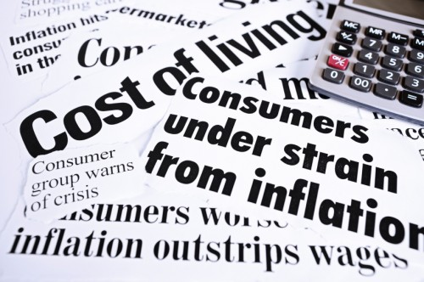
Features of Economic Environment
1. Inflation
Rise in price measured
against a standard level of purchasing power
It results when aggregate demand grows faster than aggregate supply
It affects cost of living, exchange rates, interest rates

Slide 12
Implications of Chronic inflation
It affects the cost of living as the rising prices makes it more difficult for consumers to buy products unless their income rises at same pace.
Customers cannot effectively
plan long term investments ,
no incentives to save

Slide 13
Measure of inflation
US- Consumer Price Index (CPI)
Europe- Harmonized index of Consumer Prices(HICP)
India- Wholesale Price Index (WPI)
HICP includes rural population and excludes occupied housing

Slide 14
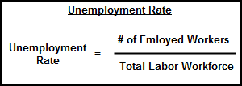

Employment
It is number of workers who want to work
but do not have jobs
Results in low economic growth, creates social
pressures and provoke political uncertainty

Slide 15
Misery Index=Inflation + Unemployment rate
Working age population
Wealthier countries population will shrink from 740million to 690mn
In poorer countries working population will increase from 3bn to 4bn
Labor Regulation- Companies think twice before they hire new employees [Hero Group]

Slide 16
DEBT
Sum of borrowing from it population, foreign organization and government
Larger the debt, more uncertain is the country’s economy
Debt of US has increased from $1 trillion in 1980 to $9.4 trillion in 2008
Types- Internal & External

Slide 17
Internal Debt- When government spends more than it collects
Imperfect tax system
External Debt- When government borrows money from foreign lenders
Ex- Zambia and Liberia has slow economic growth rate

Slide 18
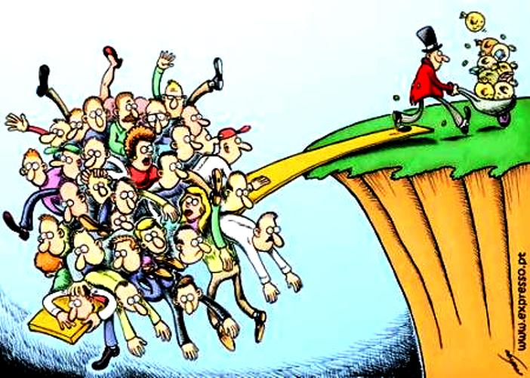
Income Distribution
Fractions of population that are at various levels of incomes.
Ginni Coefficient – assess degree of inequality in distribution of income.

Slide 19
Income Distribution among wealthy nations
US has largest inequality gap
Share of income to top 1% has increased and decreased for the poorest 40%
Urban vs Rural Income- In china urban income is 7times more than rural income

Slide 20
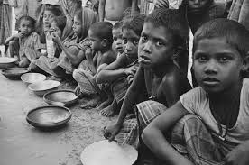
POVERTY
Poverty: Condition where a person or community is deprived of or lacks the essentials for minimum standard of well being and life.
Poverty as per World Bank:
Extreme Poverty: living less than $1 per day(PPP)
Moderate poverty: living less than $2 per day(PPP)

Slide 21
Poverty and Economic Environment:
Throughout the world people struggle for basic necessities.
In face of extreme poverty market systems may not exist, national infrastructures may not work, criminal behavior may be pervasive and governments may not be able to regulate society or adopt prudent policies.
Growth of the economy of business depends on alleviating poverty.

Slide 22

LABOR COST
LABOR COST
Key element of total cost.
Companies scan the world to identify the difference between low cost and high cost countries.

Slide 23
PRODUCTIVITY
Amount of output created per unit input used.
It is the efficiency with which goods and services are produced.

Slide 24
BALANCE OF PAYMENTS
Statement of country’s trade and financial transactions created by individuals, business and government agencies.
CURRENT ACCOUNT
CAPITAL ACCOUNT

Slide 25
ECONOMIC SYSTEM
An economic environment is a mechanism that deals with the production, distribution and consumption of goods and services.
It is a set of structures and processes that guides the allocation of resources and shapes the conduct of business activities in a country.
The spectrum of economic analysis is anchored by ideas of: i) Capitalism
ii) Communism

Slide 26
CAPITALISM
Free market system built on private ownership and control.
Owners of capital have inalienable property rights that give them right to earn a profit in return of their effort, investment and risk.
COMMUNISM
Centrally planned system built on state ownership of economic factors of production and control of all economic activity.

Slide 27
TYPES OF ECONOMIC SYSTEM
MARKET ECONOMY
COMMAND ECONOMY
MIXED ECONOMY

Slide 28
MARKET ECONOMY
A system in which individuals, rather than government make the majority of the economic decisions.
Gives individual freedom to decide where to work doing what, how to spend or save money and whether to consume now or later.

Slide 29
Private Ownership of resources under Market Economy:
Individuals make decisions therefore market economy depends on individuals and companies owning and controlling resources rather than government.
Consumers influence the allocation of resources through their demand for products.

Slide 30
Role of Government Intervention:
Depends on few government restrictions as possible.
Believes that less invisible the “hand” becomes due to government intervention , less efficiently the market will run.
The invisible hand is not infallible, given the needs for some public goods.

Slide 31
COMMAND ECONOMY
Also known as centrally planned economy.
Government owns and controls all resources.
The government commands the authority to decide what goods and services, the quantity in which they are produced and the price at which they are sold.
Governments owns the means of production which are managed by employees of state.
Prices do not change much but quality of goods dramatically affected.

Slide 32
Continued..
Most Products are short in supply.
Consumers have few alternatives.
Not much incentive for companies to innovate
Little profit to invest in upgrades.
ADVANTAGE: State has ability to mobilize unemployed or underemployed resources to generate growth.

Slide 33
MIXED ECONOMY
Fall in middle of Capitalist and communism.
System in which economic decisions are largely market driven and ownership is largely private, but the government intervenes in private economic decisions,
Has elements of – market and central planning economies.
The government owns key factors of production yet consumers and private producers influence price and quantity.

Slide 34
Government Intervention
Central, regional or local government may own some means of production.
Government can influence private production olor consumption decisions.
Government can redistribute income and wealth.

Slide 35
THANK YOU

